Slide 1


Perkins V Application Academy
February 26, 2026
Webinar #1

Slide 2

Agenda
Perkins V Requirements
2026 Changes to Perkins local application documents
Rationale for change

Slide 3
Objective & Expected Outcomes
The objective of this webinar is for each participant to:
  Comprehend 2026 changes to local application documents
Following completion of this webinar, participants will be able to:
  Identify changes to application documents
  Recall how to complete documents for their consortium
  Describe relationship between documents
  Explain rationale for change

Slide 4
Local Application—Section 134
Eligible Agency Determines Requirements
Shall Contain:
  A description of the results of the comprehensive local needs assessment
    Narrative #1
    CLNA Results & Priorities
  Narratives #2-#9
    Section 134(b)(2) – (9)

Slide 5

Local Application
Statement of Assurances
CLNA Results & Priorities
Narrative
Budget
Programs of Study
Perkins-Funded Positions
Position Descriptions
Consortium Inventory
Improvement Plan (if necessary)

Slide 6
Local Use of Funds—Section 135
To develop, coordinate, implement, or improve CTE programs to meet the needs identified in the CLNA
Support CTE programs that are of sufficient size, scope, and quality to be effective
Not required to fund all categories
Career Exploration
Professional Development
Necessary Skills
Academic Integration
Support Elements
Implement Evaluations

Slide 7
Local Application—2026 Changes
Statement of Assurances
CLNA Results & Priorities
Narrative
Budget
Programs of Study
Perkins-Funded Positions
Position Descriptions
Consortium Inventory
Improvement Plan (if necessary)

Slide 8
Rationale for Change
Provide clarity
Reduce duplication
Consolidate where possible
Remove unnecessary information
Strengthen connection between CLNA and uses of funds
Improve the applicant experience
Increase transparency & trust
Address applicant feedback

Slide 9
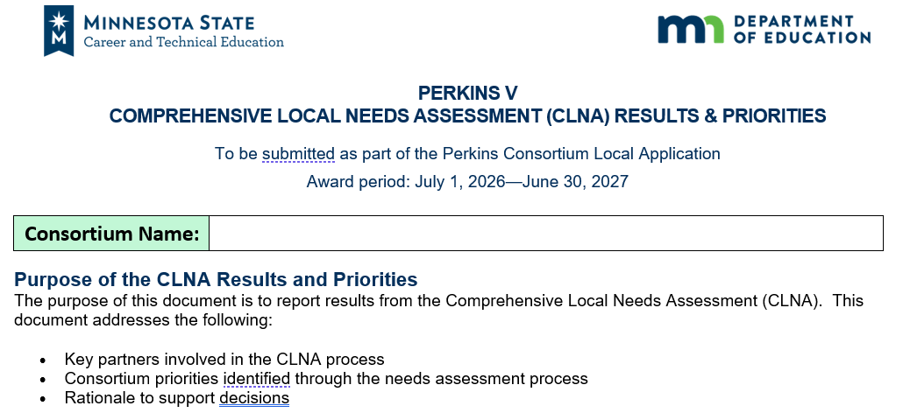
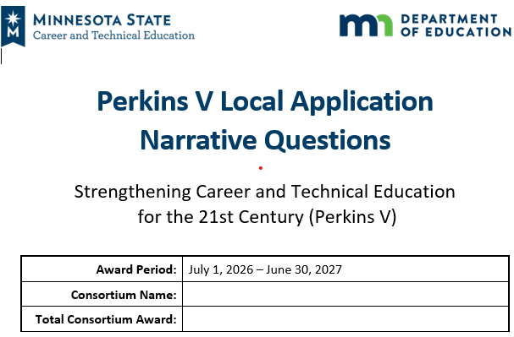
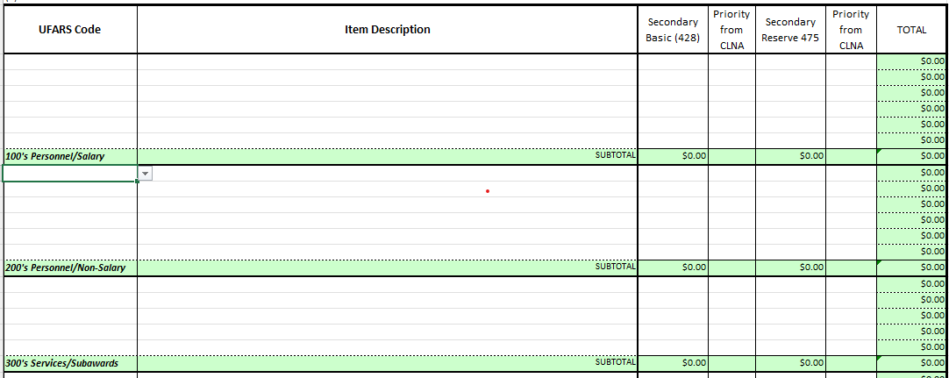
Demonstration

Slide 10
Sample
CONSORTIUM PRIORITY AND RATIONALE Health Careers Programs—Employment opportunities in the health careers are projected to grow at double-digit rates for the next few years due to the growth of specialty clinics in the region and projected retirements.
STRATEGIES Increase student access to industry-recognized credentials by reducing costs for students unable to pay testing fees. Upgrade labs with mannequins, monitoring equipment, and simulation software to run more realistic patient scenarios. Provide dedicated tutoring support.
OUTCOMES Achieve 100% accessibility rate for students wanting to complete CNA licensure. Reach 95% first-time pass rate for all licensing exams.

Slide 11
Odds & Ends
Risk Assessment
Reallocation
Operational Guide
MN Career Fields & Clusters

Slide 12

Summary
Perkins V Requirements
2026 Changes to Perkins local application documents
Rationale for change
More to come!

Slide 13


Thank you.
30 East 7th Street, Suite 350
St. Paul, MN 55101-7804
400 Stinson Boulevard Northeast
Minneapolis, MN 55413
MinnState.edu/system/cte
education.mn.gov/mde

